Slide 1
Apartment Search Near Tesla Factory

Slide 2
1. Bay area is quite expensive and for students relocating here especially it is important to have options to figure out cost efficient way of living. 2. Objective of this project is to have a narrower list of apartments filter out based on easy commute and lively neighborhood 3. Target audience for this project is anyone (mostly for students since they should not have restrictions for any particular location ) relocating to a particular area. Though in this project I have considered relocating near Tesla factory for internship.
Objective

Slide 3
Data used for this analysis is from Foursquare API It includes location co-ordinates of target location and of the apartments near to that location. Also it includes detailed information of neighborhoods in a given area.
Data

Slide 4
Get list of apartments within 5 miles from factory Narrow down the list by user specific search criteria Filter out the remaining apartments which are 0.5 miles from BART station (public transport in bay area) Compare the neighborhoods and select the one’s according to the users interests
Project Approach

Slide 5
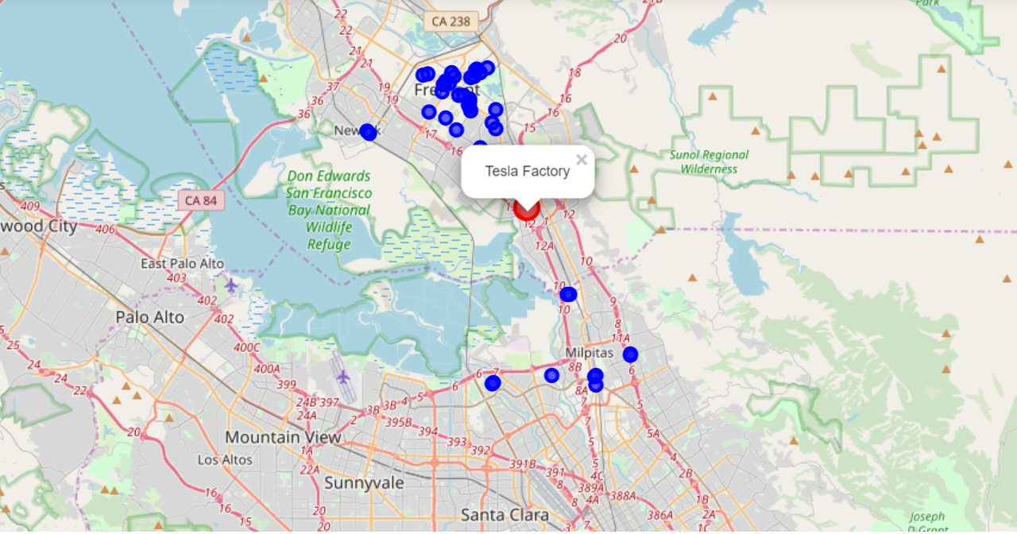
At first 41 potential apartments where found within 5 miles from the factory

Slide 6
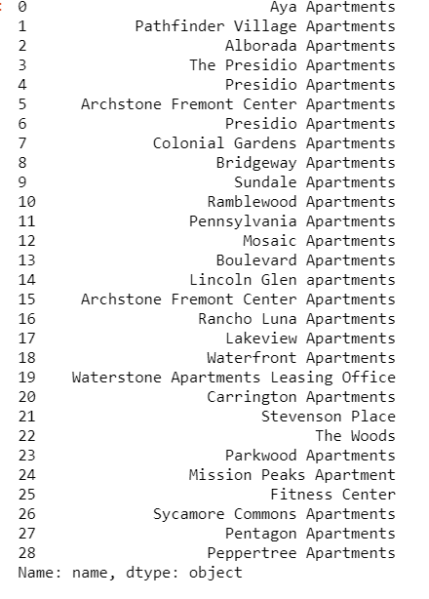
From the two areas- Fremont & Milpitas, I chose to live in Fremont area since it has easy BART commute

Slide 7
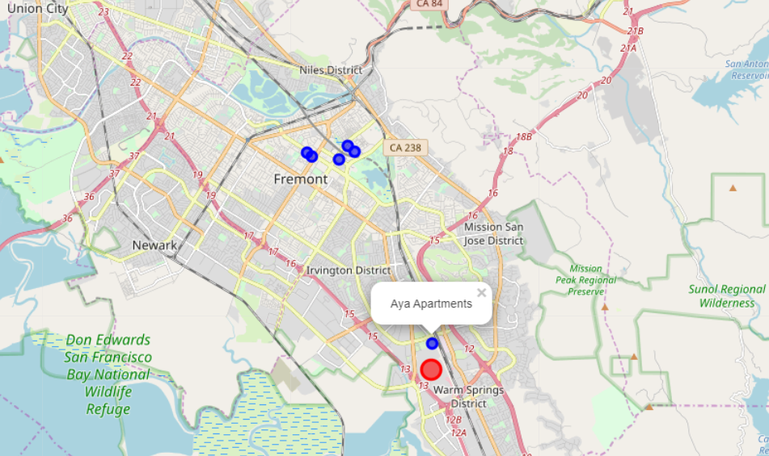
Filtering out apartments within 0.5 miles of BART station

Slide 8
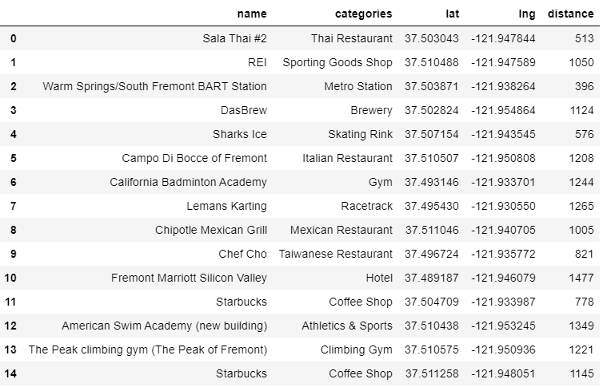
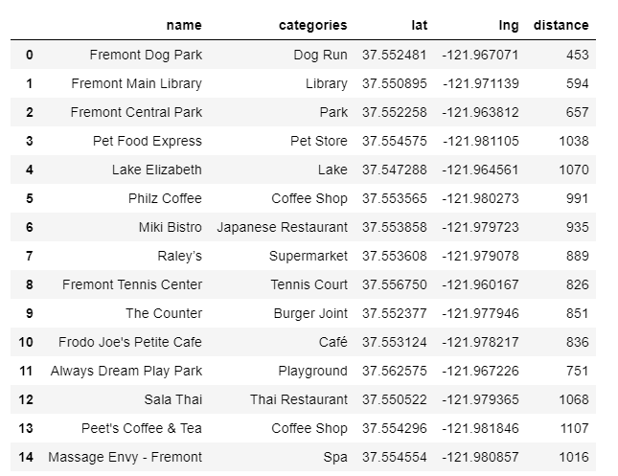
Exploring the neighborhood of the filtered apartments
Near Aya Apartments
Near all other Apartments

Slide 9
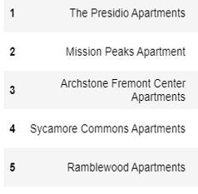
Results
Since neighborhood around all other apartments look much more lively and appealing, I chose to live around that area.
Here is the final list of 5 apartments which were filtered:

Slide 10
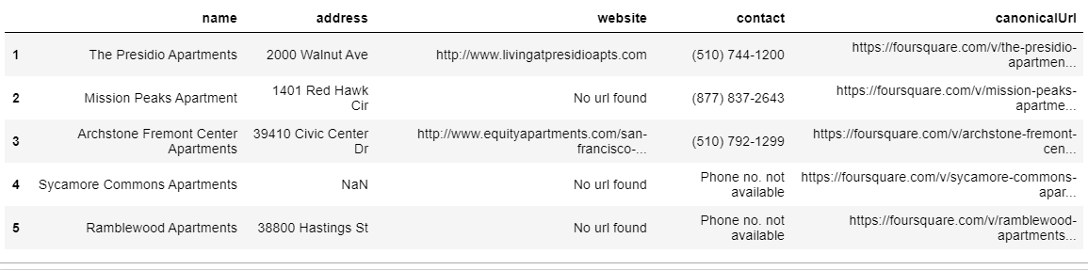
Future
Steps
Explore more about each apartment including floor plan, availability and cost by the contacting each of them.
I have pulled up their contact information from the data available in Foursquare API

Slide 11
Thank You!

